Slide 1
Managing SharePoint Search & Sandbox Solutions

Slide 2
Agenda
A Tour of Site Collection Search Settings
Defining Managed Term Sets and Keywords
Limiting Data Exposure in Search Results
Overview of Sandbox Solutions
Managing & Leveraging Sandbox Solutions

Slide 3
SharePoint Search for the SCA
Enterprise Search
FAST Search
Search Center
Site Collection level tools
Notes:
SharePoint 2010 ships with an enterprise class search engine for helping users locate content throughout the environment. This engine provides Search administrators, SharePoint server administrators who specialize in the Search application service, tools for customizing the way SharePoint catalogs and indexes content as well as what content can be searched through from within a SharePoint site.
Enterprise Search
Uses named content sources such as the SharePoint enterprise, NTFS formatted file shares, Exchange public folders, external web sites or Business Catalog Services (BCS) external data repositories. Offers a Search Center site template and Search web parts that can be used to build custom Search pages. Allows site collection administrators to customize the Search box behavior for sites in their collection (both appearance and functionality) as well as add Search tools such as scopes and keywords to enhance result relativity and steer users toward certain content.
FAST Search
Enhances the Enterprise Search engine with weighted tagging, authoritative site promotion and demotion, and more. FAST Search is a complex Enterprise search service to configure and will likely be managed by your Search service application SharePoint server administrators.
Search Center
A site template that ships in 2 versions, Basic and Enterprise, out of the box with SharePoint. The Enterprise Search Center site template boasts a very clean look with tabbed search scopes and extensible search and results pages layouts.
Site Collection Level Tools
Site collection administrators can configure the use of site collection level scopes (on or off) and the appearance of a scope drop-down menu near the search textbox that appears on every Microsoft-authored SharePoint page template. SCA’s can also create new Search scopes and keywords that will be used only in their own site collection. More on scopes and keywords in a moment.

Slide 4
Enterprise Search Settings
Enterprise Search Center
Scope Choice Display
Scopes
Default Results Page
Keywords
Enable Scopes
Notes:
Search settings are globally managed at the farm level by a SharePoint Application Services administrator and define things like what content (in SharePoint or elsewhere) will be indexed and made searchable, how often the index will get refreshed, global search scopes and much more. These settings will certainly influence the way Search behaves in your site collection but are not the only management option available.
Site collection administrators have the authority to enhance the Enterprise Search behavior on their site collection by enabling and creating site collection level scopes and designing keywords and best bets around content they wish to steer their users toward to improve productivity. The Enterprise Search Center site template can be used to provide users with a central location from which they can perform their searches and the pages of this site can be modified to provide only the functionality the site collection administrator desires.

Slide 5
FAST Search Settings
FAST Search Center
FAST Site Promotion
FAST User Context
FAST keywords and synonyms
Notes:
Internet and Intranet Searching has taken a drop in popularity polls within the last year or so. User s
SharePoint 2010 incorporates Microsoft’s newest enterprise class Search engine, FAST. This search engine is highly extensible and customizable, even by end users. FAST can take advantage of user tagging and administrators’ opinions on which sites hold the data most likely to be useful and deliver a heavily weighted, highly relative search result list.
Using a FAST Search Center, users can take advantage of many prescribed sets of search results as well as find data not by any property of the data itself (as with Enterprise Search), but rather by degree of popularity or through community opinion.
FAST, like Enterprise Search Center, uses keywords to identify related data and steer users toward specific content. However a couple of the downsides to keywords is that they must be an identical match to the data in order for that data to show up as a result, which means they must be correctly spelled and in the correct case if you are running SharePoint on a case sensitive platform.
FAST can also help administrators ‘promote’ certain sites over others if that is their wish. But lastly, and perhaps the most powerful functionality is FAST’s ability to weight search results according to user tagging.

Slide 6
DEMO
SharePoint Search
Notes:
In this demonstration, your instructor will illustrate:
Enterprise Search Center
Tour the Enterprise Search Settings
Tour the FAST Search Settings

Slide 7
Agenda
A Tour of Site Collection Search Settings
Defining Managed Term Sets and Keywords
Limiting Data Exposure in Search Results
Overview of Sandbox Solutions
Managing & Leveraging Sandbox Solutions

Slide 8
Managed Term Sets and Keywords
Managed Term Sets
Keywords
Defined at farm level and/or site collection level
Metadata crossing for relativity verification
Improve search
Defined at farm and/or site collection level
Alias words or phrases that describe a resource
Improve search
Notes:
SharePoint 2010 offers two ways to help your users find what they’re looking for when they aren’t exactly sure what they’re looking for. Managed Term Sets are configured collections of metadata that can be used for comparison when the Search engine builds a result set for a user search. SharePoint farm administrators create these term sets full of metadata combinations in the application services at the farm level. Site collection administrators can take advantage of the Managed Term Sets at the site collection level.
Keywords are a simpler method of directing SharePoint to provide specific content as the result for searches containing certain words of phrases. One of the downsides to Keywords is that they must be created and maintained statically and are difficult to base on complex algorithms of if→then logic (such as may be possible with Manager Term Sets).

Slide 9
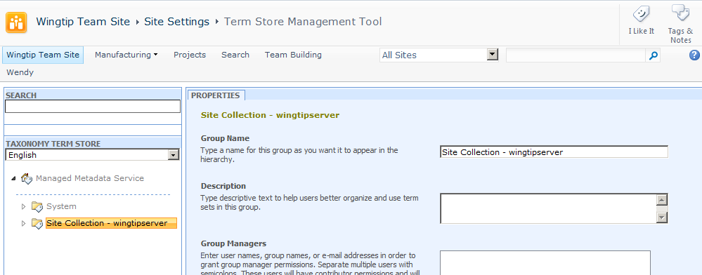
Managed Term Sets Term Store
Notes:
Site administrators can name Group Managers to the Term Store so that those users may then create new term store groups (or sets). In this way, the responsibility for determining which content is related to which other content can be delegated to those who know the content best, the information workers.
Site administrators may either build the term set statically in the management tool (seen above), or a text file can be easily imported if it already contains the terms needed. These terms can then be used for tagging as well as Search enhancement.

Slide 10
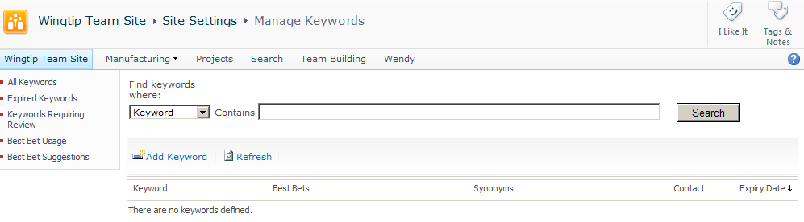
Enterprise Search Keyword Management
Notes:
Enterprise Search manages keywords both at the farm level and the site collection level. From the Site Settings menu, site collection administrators can create and manage keywords that will be recognized during a search operation conducted from any site throughout the collection.
Keywords steer users toward specific content by being associated with a Best Bet option (also configurable at both the farm level and the site collection level). The Best Bet contains the URL(s) of those sites that the site collection administrator believes would best serve a user who is searching for the keyword. Enterprise Search includes a web part for Search Results pages called the Best Bet web part that will expose the best bets that hit for a given search operation.

Slide 11
DEMO
Keywords & Best Bets
Notes:
In this demonstration, your instructor will illustrate:
How to create a keyword.
How to create a Best Bet.
How to employ keywords during a search operation.
How to employ a Managed Term Set.

Slide 12
Agenda
A Tour of Site Collection Search Settings
Defining Managed Term Sets and Keywords
Limiting Data Exposure in Search Results
Overview of Sandbox Solutions
Managing & Leveraging Sandbox Solutions

Slide 13
Limiting Search Results
Site Administration – Search and Offline Availability
List/Library Column – Searchable Columns
Search Scope Rules – Exclude behavior
Notes:
Site administrators (and site collection administrators) can choose to hide their content from search results in order to comply with regulations regarding sensitive information or to reduce the overhead on the SharePoint server. Content can be hidden for an entire site, a specific site column(s), or a custom search scope (based on a web address or property query).
Site Administration – The Search and offline availability link in Site Settings under the Site Administration heading offers a Yes/No option as to whether any/all content from the site should be indexed and therefore available in search results.
Column Administration – The Searchable columns link in Site Settings under the Site Administration heading offers a checkbox for each site column in the site column gallery…administrators can select those columns they wish to EXCLUDE from the index and therefore from the search results (by default all columns are indexed).
Search Scope Rules – defined according to a web address or property query, a search scope can be set to a Behavior property of exclude to prevent any result items matching the rule from appearing in the search results.
NOTE: Search Scope rules with Exclude behavior do not prevent the content from being built into the index, just merely from appearing on the results page.

Slide 14
DEMO
Customizing Search
Notes:
In this demonstration, your instructor will illustrate:
How to disable site search and offline availability
How to exclude certain columns from the index
How to create and employ a Search Scope Rule with Exclude behavior

Slide 15
Agenda
A Tour of Site Collection Search Settings
Defining Managed Term Sets and Keywords
Limiting Data Exposure in Search Results
Overview of Sandbox Solutions
Managing & Leveraging Sandbox Solutions

Slide 16

SharePoint 3.0’s Challenge
Developers build custom solutions
Administrators can only secure solutions with CAS
Hard to control what is being done in custom code
Biggest cause of SharePoint support cases: custom solutions with code
Developer
Design, build, and test custom solutions
Administrator
Install and monitor custom solutions
Site Collection Owner
Activate and use custom solutions
Notes:
The product SharePoint releases the burden on IT departments by allowing end-users to manage the information structure.
This is an important part to the success of SharePoint, the core concept of sites, lists and libraries and provisioning.
However, the real value lies in the customizations that enable you to maximize the potential that sits in the templates provided by SharePoint.
In SharePoint 2007 you still need IT to install and maintain these customizations. This slows down business and impacts IT unnecessarily.

Slide 17
SharePoint 2010 Approach
Developers build custom solutions
Site collection owners deploy, activate and implement the customizations
Administrators leverage resource monitors to check site collection usage
Automatic triggers “turn off” custom solutions in a site collection that are too expensive and taxing on the server
Developer
Design, build, and test custom solutions
Site Collection Owner
Deploy, activate and use custom solutions
Administrator
Monitor custom solutions
Take action when custom solution causes problems
Notes:
SharePoint 2010 allows customizations to be deployed and maintained at the site collection level.
Increasing agility while releasing burden on IT.
Of course there is still IT involvement, but mainly when things go wrong (such as excessive resource usage).

Slide 18
Introducing Sandboxed Solutions
Sandboxed solution: site collection owners can upload to SharePoint
Empowers site collection owners to deploy new functionality w/o involvement of IT
Local/remote development options
Self-regulating and monitored by IT
Limited set of permissions & functionality
Resource quotas established & monitored by IT
Secure: site collection owner is in control
Notes:
Sandboxed solutions allow more custom code deployment flexibility by site collection owners, at the same time putting up guards to protect the server.
Sandboxed solutions execute with limited permissions and functionality.
System resources like memory and CPU cycles are limited by quotas.

Slide 19
Sandboxed Solutions Help Enterprises
Sandboxed solutions are important because
Solve SharePoint hosting issues in corporate environments
Hosted environments much easier to manage
Reduces time to deploying custom solutions
Removing process of getting code approved and deployed by IT
Improves stability of SharePoint servers
Now badly performing code isolated to site collection rather than potentially bringing down an entire server
Notes:
Site collections are empowered to deploy custom code that will run within a sandbox thus not hurt the system.
No longer need to get admins involved in deployment.
Solutions that risk the stability of the farm can be shut down.

Slide 20
Sandboxed Solution Elements
List Definitions & Instances
WebTemplate Feature elements
Site Columns & Content Types
Modules (files)
Feature Receivers
Web Parts
Event Receivers (item, list & Web receivers)
Custom Actions
Declarative workflows
Notes:
You can access the list and library data within the site collection.

Slide 21
Agenda
A Tour of Site Collection Search Settings
Defining Managed Term Sets and Keywords
Limiting Data Exposure in Search Results
Overview of Sandbox Solutions
Managing & Leveraging Sandbox Solutions

Slide 22
Uploading Sandbox Solutions

Slide 23
Using Sandbox Solutions

Slide 24
Sandboxed Solution Lifecycle
Installation
Upload into Solution Gallery
Activation
Auto-activates features
Deactivation
Inert operation, extended by developer
Web Parts no longer execute
Deletion
Solution is validated upon installation
Notes:
The way people install and interact with a sandboxed solution is similar to normal solutions, but slightly automated.
Important concept to hit is the fact that solutions get validated before they are allowed to be installed, and that you can extend this validation.
After installation the solution is activated, which auto-activates features.
Deactivation is a different story. The main thing that is visible are Web Parts executing from the sandbox. They will no longer execute.
If you re-activate the solution the Web Parts will start executing again.

Slide 25
Sandbox Solution Monitoring
Site collection quotas specify the warning and hard limits for number of resources that can be used per day
Sum of resource measures are taken across solutions deployed to site collection
i.e.: add up CPU Points for all solutions
Max of resource utilization measures checked against site collection quota to determine if it should be throttled / blocked
Current usage reports found in the Solution Gallery (top-level site in site collection)
Notes:
Resource monitors keep sandbox solutions from over taxing the server.
The SUM of all resource measures is the number applied to the quota.
The MAX of all resource measures is used to determine if the sandbox should be turned off for a given solution for the rest of the day.

Slide 26
Summary
A Tour of Site Collection Search Settings
Defining Managed Term Sets and Keywords
Limiting Data Exposure in Search Results
Overview of Sandbox Solutions
Managing & Leveraging Sandbox Solutions

